Slide 1

Arduino with ESP32
Internet of Things Club

Slide 2

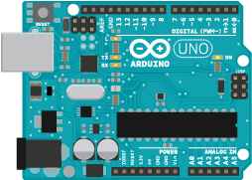
What exactly is Arduino
Arduino is both a hardware and software platform, consisting of Arduino branded hardware and 3rd party hardware, often referred to as clones as it is open sourced
Why chose Arduino
Easy to use
Based on wire (a c++ language) which supports “cores” allowing custom
hardware
Huge community behind it
Arduino UNO based off an Atmel avr

Slide 3
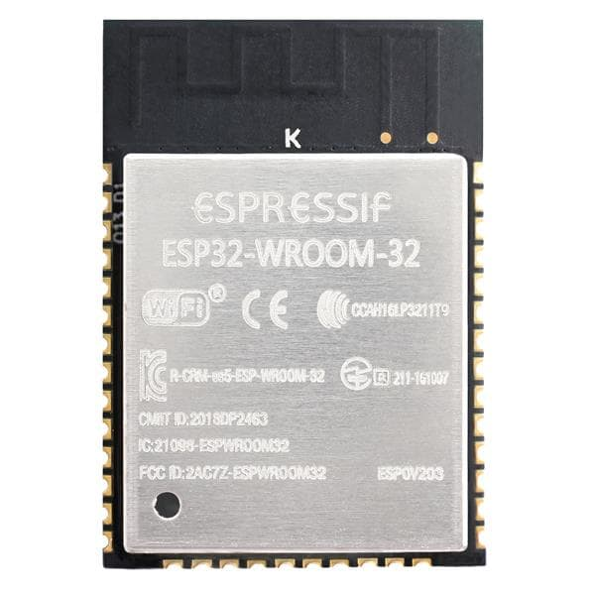
What is an ESP32
An ESP32 is a microcontroller make by espressif that has in built WiFi
Has 2 cores running between 80MHz to 240MHz
Can run an OS on it
How are we going to use them?
We will be programming them using the Arduino programming language
Running in an OS called FreeRTOS
Notes:
Other ways to program ESP32:
ESP-IDF (direcly running on top of FREERTOS)
AT commands
lua
micro python
...

Slide 4
Installing Arduino and ESP32 core
Get Arduino IDE:
www.arduino.cc/en/Main/Software and download the IDE
Install once downloaded
Install ESP32 core
In the IDE, file→preferences, at the bottom in additional board manager URL add https://dl.espressif.com/dl/package_esp32_index.json
Tools→boards→board manager, search for esp32 and install it
Test the installation by selecting esp32 dev-kit in boards and hit the verify button in a new sketch
Download the examples from github.com/prying/ESP32WorkshopWeek8
Notes:
Other ways to program ESP32:
ESP-IDF (direcly running on top of FREERTOS)
AT commands
lua
micro python
...

Slide 5
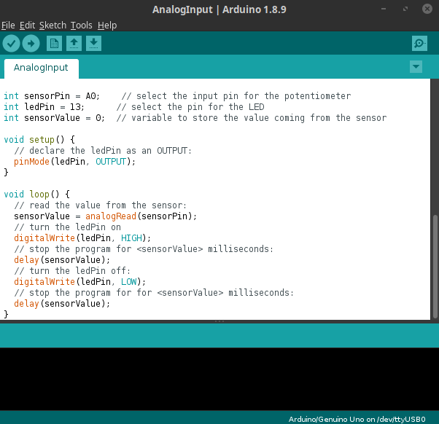
Arduino IDE
Verify | Upload
Serial Monitor
Code here only runs once before loop()
Code here will run until the microcontroller stops
Compiler output

Slide 6
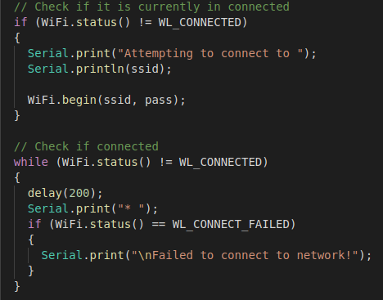
Connecting to WiFi
Open section 1 and open the .Ino file
How do we connect to WiFi?
What do we need to protect against?
Try it yourself
You will need to create an access point with your phone and change MY_SSID and PASSWORD to your hot spots credential e.g. ssid[] = “myPhone”
To see the output under tools open serial monitor and change the baud rate to 115200

Slide 7

How to call an API
Connect to a server
Make a HTTP request from a server
A typical HTTP request looks something like this:
The server will then reply with a header, and if applicable with a body I.e a web page.
After this exchange the connection to the server can be closed

Slide 8
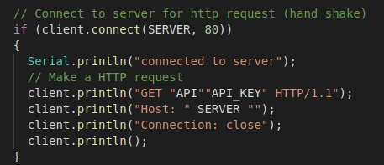
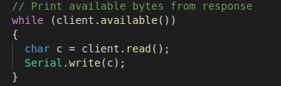
How is this implemented in Arduino
Open section 2 and open the .Ino file
How do we implement a HTTP request?
Create a WiFiclient object
Open a connection to the server
Read the received message when available
Close the connection by client.stop();

Slide 9

Running the code (section 2&3)
Examples 2 and 3 use a free API from openweathermaps.org
To sign up for the API go to https://openweathermap.org/api
Signing up only requires an email
Once signed up click sign in, sign in then go to the API Keys page and copy the API key to where YOUR_KEY is

Slide 10
Challenge
Using the API at iottemperatureapi.azurewebsites.net send a temperature to be recorded (this doesn't actually need to be a temperature)
First get a key (/getkey)
To send data use /update?key=YOUR_KEY&temp=YOUR_TEMP
View the data submitted to the key by using /?key=YOUR_KEY
Tips:
client.print() wont and a new line character (\n) to the end
Connect to the server first ( iottemperatureapi.azurewebsites.net is the server in this case)
Notes:
Other ways to program ESP32:
ESP-IDF (direcly running on top of FREERTOS)
AT commands
lua
micro python
...

